Slide 1
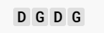
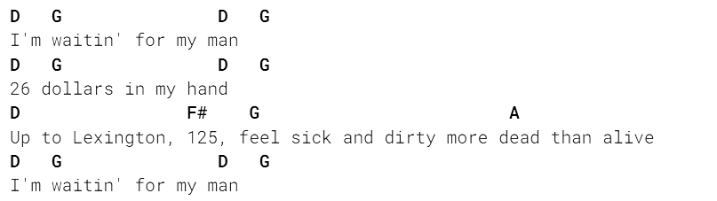
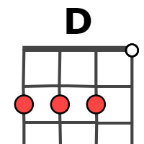
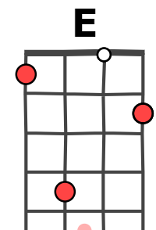

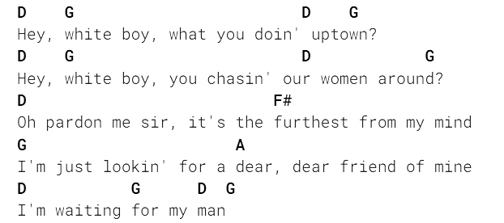
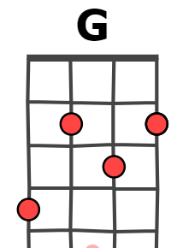
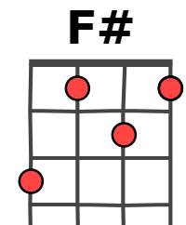
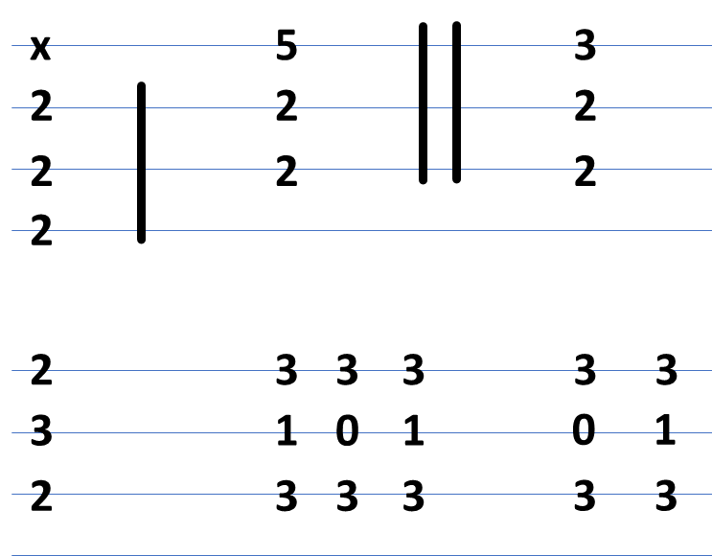
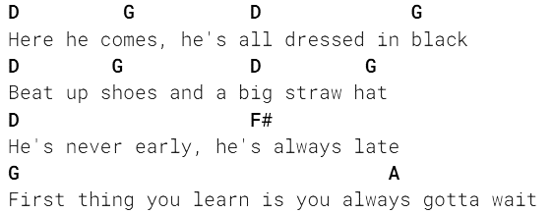
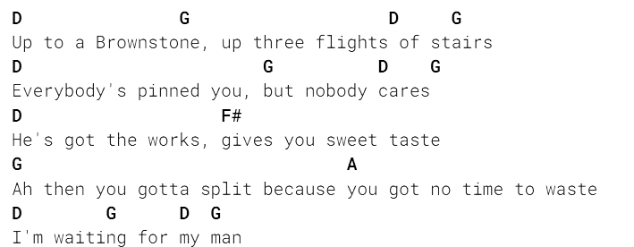
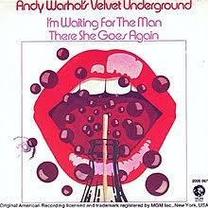
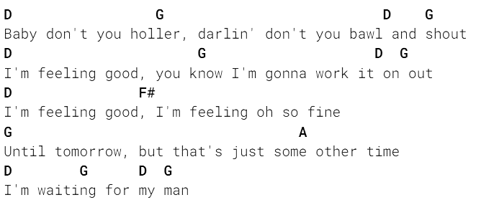
I’m waiting for the man - The Velvet Underground
(1969)
INTRO
121 BPM
Verse 1
Verse 2
Verse 3
. Instrumental break
Verse 4
Verse 5
Outro
Oh, it's alright
Huh huh
Merci à tabs.ultimate-guitar.com !

Slide 2
If You Close The Door - The Velvet Underground
[Verse 1]
I'm waiting for my man
Twenty-six dollars in my hand
Up to Lexington, 1-2-5
Feel sick and dirty, more dead than alive
I'm waiting for my man
[Verse 2]
Hey, white boy, what you doin' uptown?
Hey, white boy, you chasin' our women around?
Oh, pardon me, sir, it's furthest from my mind
I'm just lookin' for a dear, dear friend of mine
I'm waiting for my man
[Verse 3]
Here he comes, he's all dressed in black
PR shoes and a big straw hat
He's never early, he's always late
First thing you learn is that you always gotta wait
I'm waiting for my man
Oh, work it now
[Instrumental Break]
[Verse 4]
Up to a brownstone, up three flights of stairs
Everybody's pinned you, but nobody cares
He's got the works, gives you sweet taste
Ah, then you gotta split because you got no time to waste
I'm waiting for my man
[Verse 5]
Baby don't you holler, darlin' don't you bawl and shout
I'm feeling good, you know I'm gonna work it on out
I'm feeling good, I'm feeling, oh, so fine
Until tomorrow, but that's just some other time
I'm waiting for my man
Walk it home
[Outro]
Oh, it's alright
Huh huh
121 BPM

Slide 3
x
5
3
2
2
2
2
2
2
2
2
3
3
3
3
3
3
1
0
1
0
1
2
3
3
3
3
3

